Slide 1


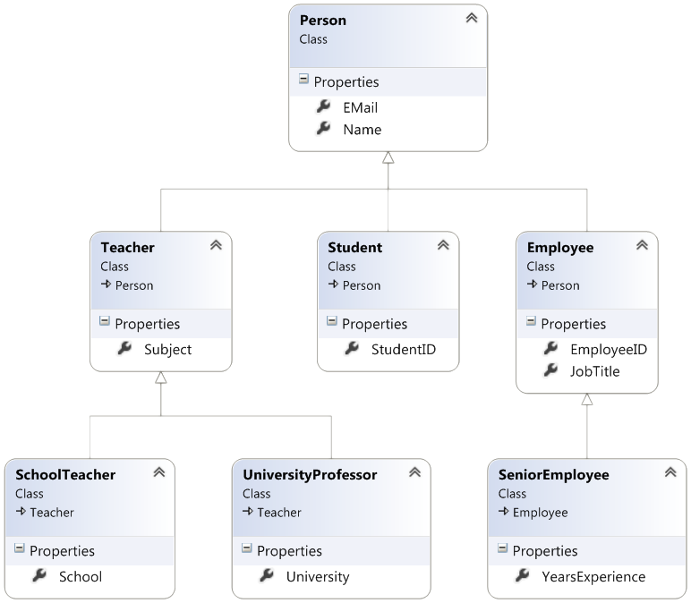

Inheritance
Class Hierarchies
C# OOP
Basics
SoftUni Team
Technical Trainers
Software University
http://softuni.bg

Slide 2
Table of Contents
Fundamental Principles of OOP
Inheritance
Class Hierarchies
Inheritance and Access Levels

Slide 3
Questions
sli.do #9721

Slide 4
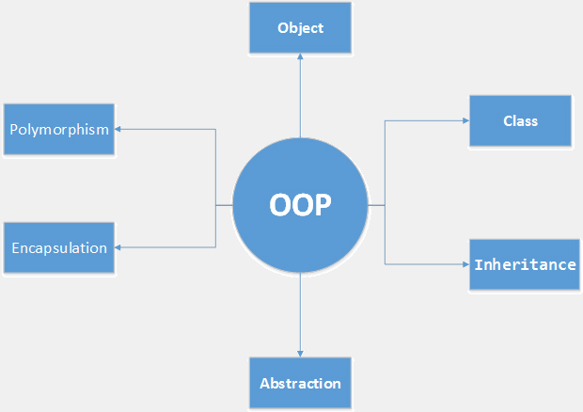
Fundamental Principles of OOP
Notes:
(c) 2006 National Academy for Software Development - http://academy.devbg.org*
4##

Slide 5
Fundamental Principles of OOP
Encapsulation
Inheritance
Inherit members from parent class
Inherit constructors from parent class
Polymorphism
Abstraction

Slide 6
Inheritance
Notes:
(c) 2006 National Academy for Software Development - http://academy.devbg.org*
6##

Slide 7
Types of Inheritance
base class /
parent class
derived class
inherits
Notes:
Base (parent) class
The class giving its members to its child class
Derived (child) class
The class taking members from its base class

Slide 8
Types of Inheritance (2)
class
implements
interface

Slide 9
Types of Inheritance (3)
derived interface
extends
base interface

Slide 10
Inheritance – Benefits
Extensibility
Reusability
Provides abstraction
Notes:
Extensibility / Polymorphism: New functionality may be easily plugged in without changing existing classes as long the new plug-in classes extend given base classes.
Reusability: For a set of similar applications a framework can be defined using a core set of classes that are to be extended by classes that fill in the application-dependent part.
Information Hiding: If a more general class using a simpler contract is sufficient, details from extending classes may be hidden to some of the client classes. This allows them to be more independent from possible changes and diminishes the load of contracts that must be understood by a reader of these client classes.
(c) 2006 National Academy for Software Development - http://academy.devbg.org*
10##

Slide 11

Examples - Incorrect
Don't use it to build has-a relationship
E.g. dog has-a name (dog is not a kind of name)
Notes:
(c) 2006 National Academy for Software Development - http://academy.devbg.org*
11##

Slide 12

Examples - Correct
Use inheritance for building is-a relationship
E.g. dog is-a animal (dog is kind of animal)
Notes:
(c) 2006 National Academy for Software Development - http://academy.devbg.org*
12##

Slide 13
How to Define Inheritance?
class DerivedClass : BaseClass

Slide 14
How to Define Inheritance? (2)
Use base to invoke the parent constructor
public Circle(int x, int y)
: base(x, y)
{
}

Slide 15

Exercises in Class

Slide 16
Inaccessible Members
Private members are hidden

Slide 17
Inheritance – Example
Base class
Person
+Name: string
+Address: string
Derived class
Derived class
Employee
Student
+Company: string
+Salary: decimal
+School: string

Slide 18
Class Hierarchies
Game
SinglePlayerGame
MultiplePlayersGame
Minesweeper
Solitaire
BoardGame
Chess
Backgammon

Slide 19

Simple Inheritance
Live Demo

Slide 20
Access Modifiers in C#
public
private
protected
internal
protected internal
Notes:
public – access is not restricted
private – access is restricted to the containing type
protected – access is limited to the containing type and all types derived from it
no modifier – access is limited to the current assembly
protected internal– access is limited to the current assembly or types derived from the containing class

Slide 21
Inheritance: Important Aspects
There is no multiple inheritance

Slide 22
Inheritance: Important Aspects (2)
Constructors are not inherited

Slide 23
Inheritance: Features
Extended class could freely add new members, but could not remove derived members

Slide 24
Inheritance: Features (2)
New members with the same name or signature hides the inherited ones

Slide 25
Exercises in Class

Slide 26

Inheritance Hierarchies
UML class diagrams
Notes:
Classes are represented by rectangles
Relations between classes are shown as arrows
Closed triangle arrow means inheritance
Other arrows mean some kind of associations

Slide 27
UML Class Diagram – Example
interface
Shape
struct
ISurfaceCalculatable
Point
#Position:Point
+CalculateSurface:float
+X:int
+Y:int
+Point
Square
Rectangle
struct
Color
-Size:float
-Width:float
-Height:float
+RedValue:byte
+Square
+GreenValue:byte
+CalculateSurface:float
+Rectangle
+BlueValue:byte
+CalculateSurface:float
+Color
FilledSquare
FilledRectangle
-Color:Color
-Color:Color
+FilledSquare
+FilledRectangle

Slide 28
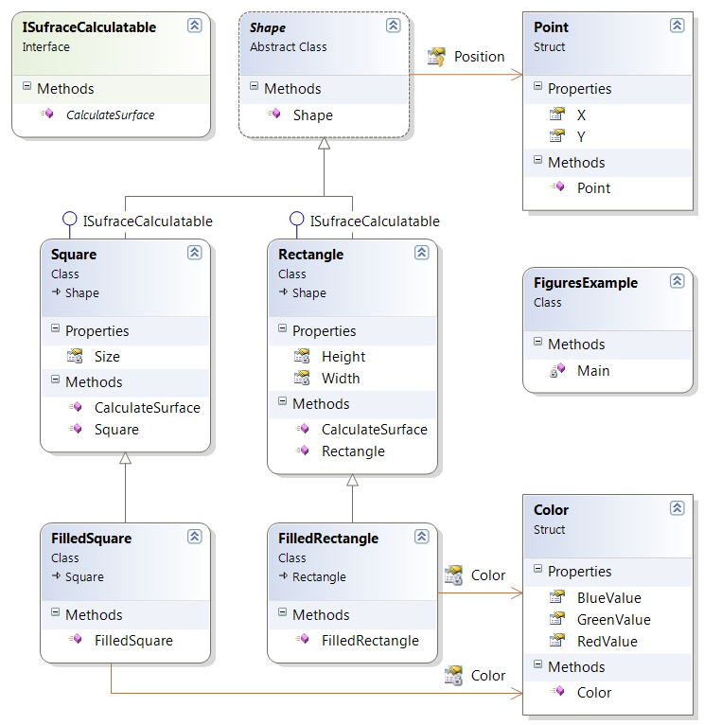
Class Diagrams in Visual Studio
Live Demo

Slide 29

Summary
Inheritance allows extending the behavior of the classes
Inheriting Fields
Inheriting Methods
Reusing the existing code

Slide 30









Inheritance
https://softuni.bg/csharp-basics-oop

Slide 31

License
This course (slides, examples, demos, videos, homework, etc.) is licensed under the "Creative Commons Attribution-NonCommercial-ShareAlike 4.0 International" license
Attribution: this work may contain portions from
"Fundamentals of Computer Programming with C#" book by Svetlin Nakov & Co. under CC-BY-SA license
"OOP" course by Telerik Academy under CC-BY-NC-SA license

Slide 32





Free Trainings @ Software University
Software University Foundation – softuni.org
Software University – High-Quality Education, Profession and Job for Software Developers
softuni.bg
Software University @ Facebook
facebook.com/SoftwareUniversity
Software University @ YouTube
youtube.com/SoftwareUniversity
Software University Forums – forum.softuni.bg

